Slide 1
IO
www.cybage.com
Copyright © 2019 Cybage Software Pvt. Ltd. All Rights Reserved. Cybage Confidential. www.cybage.com

Slide 2
Agenda
Concept of Streams
Binary Stream Vs Character Stream
File – Reading and Writing
Stream Layering and Handling Primitive Data
Serialization and De-Serialization
New File System API (NIO)
www.cybage.com

Slide 3
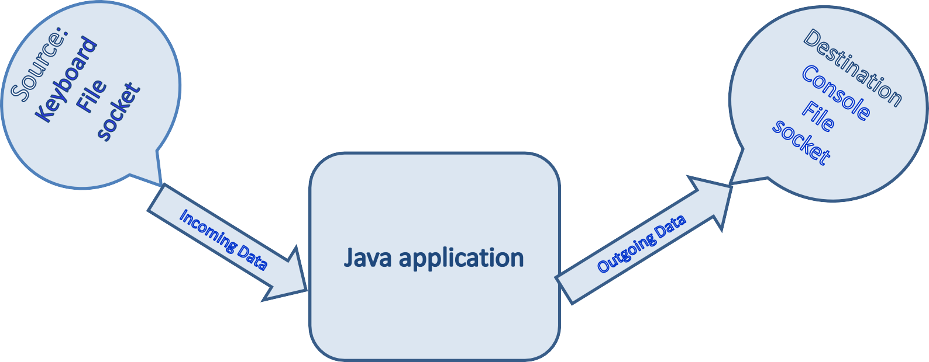
Concept Of Streams
Input Stream: read()
Output Stream: write()
Flow of data is depicted as Stream
Input Stream : Flow of data from a source to java application Output Stream: Flow of data from application to some destination
www.cybage.com

Slide 4
Concept Of Streams
I/O Fundamentals
A stream can be thought of as a flow of data from a
source or to a sink.
A source stream initiates the flow of data, also called an
input stream.
A sink stream terminates the flow of data, also called an output stream.
Sources and sinks are both node streams.
www.cybage.com

Slide 5
Binary Stream Vs Character Stream
Two Major Hierarchies in Java:
Binary Stream (Data
in Binary mode)
Character Stream
(Data in Text mode)
Java technology supports two types of streams:
character and byte.
Input and output of character data is handled by
readers and writers.
Input and output of byte data is handled by
Input streams and output streams:
Normally, the term stream refers to a byte stream.
The terms reader and writer refer to character
streams.
www.cybage.com

Slide 6
InputStream and OutputStream Methods
The InputStream Methods:
The three basic read methods are: int read()
int read(byte[] buffer)
int read(byte[] buffer, int offset, int length)
The OutputStream Methods:
The three basic write methods are: void write(int c)
void write(byte[] buffer)
void write(byte[] buffer, int offset, int length)
Other methods include:
void close()
void flush()
www.cybage.com

Slide 7
Reader and Writer Methods
The Reader Methods
The three basic read methods are:
int read()
int read(char[] cbuf)
int read(char[] cbuf, int offset, int
length)
The Writer Methods
The basic write methods are:
void write(int c)
void write(char[] cbuf)
void write(char[] cbuf, int offset, int length) void write(String string)
void write(String string, int offset, int length)
Other methods include:
void close()
void flush()
www.cybage.com

Slide 8
File Stream I/O
File Stream I/O
For file input:
Use the FileReader class to read characters.
Use the BufferedReader class to use the readLine method.
For file output:
Use the FileWriter class to write characters.
Use the PrintWriter class to use the print and println methods.
www.cybage.com

Slide 9
File – Reading and Writing
The java.io package enables you to do the following steps:
Create File objects
Manipulate File objects
Read and write to file streams
www.cybage.com

Slide 10
Standard Streams
Standard Streams : feature provided by many operating systems.
By default, they read
write output to display.
•
input from the keyboard
They also support I/O operations on files.
System.in
System. out
System. err
: used to read input from the keyboard.
: used to write output to display.
: used to write error output
www.cybage.com

Slide 11
Serialization and De-Serialization
Java supports Persistence
The state of Java Objects can be stored permanently (to some file….) Advantage: Future Reuse.
Serialization & Deserialization :
It is the process of saving an object's state to a sequence of bytes &
the process of rebuilding those bytes into a live object at some future time
Streams & methods provided: ObjectOutputStream : writeObject() ………..
ObjectInputStream : readObject() ……….
Serialization
Deserialization
www.cybage.com

Slide 12
Serializable : A tagging interface
We need to implement Serializable interface to a class Object which we need to persist.
Object Serialization is not possible if class does not implement
Serializable interface.
In such case, NotSerializableException will be thrown.
www.cybage.com

Slide 13
New File System API –NIO 2.0
Those who worked with Java IO may still remember the headaches that framework caused. It was never easy to work seamlessly across operating systems or multi-file systems. There were methods such as delete or rename that behaved unexpected in most cases. Working with symbolic links was another issue.
With the intention of solving the above problems with Java IO, Java 7
introduced an overhauled and in many cases new API.
The NIO 2.0 has come forward with many enhancements. It’s also introduced new classes to ease the life of a developer when working with multiple file systems.
www.cybage.com

Slide 14
Working With Path
A new java.nio.file package consists of classes and interfaces such as Path, Paths, FileSystem,FileSystems and others.
A Path is simply a reference to a file path. It is the equivalent (and with more features) to java.io.File. The following snippet shows how to obtain a path reference to the “temp” folder:
public voidpathInfo() {
Path path= Paths.get("c:\Temp\temp"); System.out.println("Number of Nodes:"+ path.getNameCount());
System.out.println("File Name:"+ path.getFileName()); System.out.println("File Root:"+ path.getRoot()); System.out.println("File Parent:"+ path.getParent());
}
www.cybage.com

Slide 15
Files In NIO
Deleting a file or directory is as simple as invoking a delete method on Files (note the plural) class. The Files class exposes two delete methods, one that throws NoSuchFileException and the other that does not.
The following delete method invocation throws NoSuchFileException, so you have to handle it:
Files.delete(path);
Where as Files.deleteIfExists(path) does not throw exception (as expected) if the file/directory does not exist.
You can use other utility methods such as Files.copy(..) and Files.move(..) to act on a file system efficiently.
www.cybage.com

Slide 16
NIO 2.0 Enhancement – File System Change Notification
File System Change Notification
The java.nio.file package has a WatchService API to support file change notification.
User can register directory/directories to watch and specify type of events
to monitor. Various types of events are -
ENTRY_CREATE - A directory entry is created. ENTRY_DELETE - A directory entry is deleted. ENTRY_MODIFY - A directory entry is modified.
www.cybage.com

Slide 17
NIO 2.0 Enhancement – File System Change Notification
FileSystem fileSystem = FileSystems.getDefault() WatchService wService = fileSystem.newWatchService(); Path dir = ...;
try {
dir.register(wService, ENTRY_CREATE, ENTRY_DELETE); WatchKey key = wService.take(); //or wService.poll();
:
} catch (IOException x) {
System.err.println(x);
}
First step is to create WatchService using FileSystem.newWatchService() method.
Next step is to registered instance of WatchService with object that implements Watchable interface. Java.nio.file.Path implement Watchable interface.
WatchService has methods take(), poll() and close()
www.cybage.com

Slide 18
NIO 2.0 Enhancement – File System Change Notification
for (;;) {
WatchKey key = watcher.take();
for (WatchEvent event : key.pollEvents()) { String file = object.context().toString(); if (event.kind() == ENTRY_DELETE) {
System.out.println("Delete: " + file);
} if (event.kind() == ENTRY_CREATE) { System.out.println("Created: " + file);
}
}
}
Infinite for loop waits for incoming events. When event occurs key is signaled and place into watcher queue.
Inner for loop retrieves pending events for the WatchKey & process as needed.
Reset key and resume waiting for the events.
www.cybage.com

Slide 19

www.cybage.com

Slide 20



Thank You!
Any Questions ?
www.cybage.com
Copyright © 2019 Cybage Software Pvt. Ltd. All Rights Reserved. Cybage Confidential._{6/4/2021} www.cybage.com 34

